Slide 1

Research Mentor Training Class 3: Revisiting Diversity Challenges Feedback
Tammy R. L. Collins, Ph.D.

Slide 2
Overview
Discussion-based—requires group participation led by a facilitator
Confidentiality: This is important for open discussions and everything discussed remains confidential

Slide 3
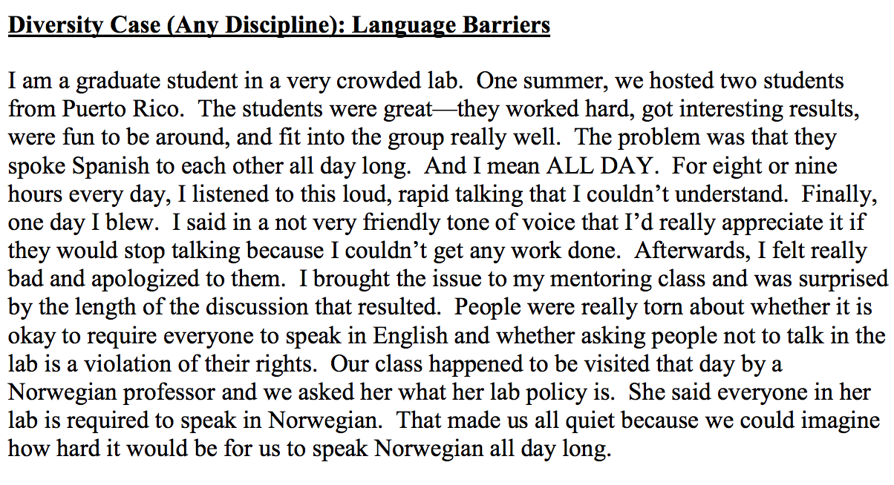

Slide 4
Diversity Scenarios
Discuss in pairs

Slide 5
Last Week’s Homework
Ethics
Talk about ethics with the youngest member of your group
Diversity
Differences between you and your mentee (or mentor)
From the Readings, what highlights impacted you the most?

Slide 6
Challenges
Not being mentored by who they thought they would be mentored by
How to re-engage a person who is “checking out”
Dealing with electronic distractions
Dealing with scheduling issues

Slide 7
Immediate Feedback | Specific Situations
Should the behavior continue or be changed in the future? Why should it be changed? How can it be changed?
S
Describe the situation or provide some background-attach to a time, place, or circumstance to put the occurrence in context.
Situation
F
B
Future
Behavior
Given the action, what was the impact on the science? Alternatively, what was the impact on you? Describe your feelings or thoughts.
Given the situational context, what is the observable behavior or action? Be as specific as you can.
Impact
I
Notes:
immediate feedback for specific situation

Slide 8
During the most recent protein prep you made last week using the FPLC,
In the future, could you please remember to clean the FPLC after you use it so we can keep it working properly for everyone in the lab?
the columns were not cleaned afterwards and everything was left in high salt.
S
F
B
I
This caused some of the columns to clog and burst, delaying my experiments and costing the lab money to replace them.

Slide 9
The XXXX equipment is used by signing up for a time slot. Yesterday,
In the future, could you please make sure to check whether someone has signed up for the equipment before using it?
I noticed that you were using the equipment during the time I signed up for.
S
F
B
I
This ruined a critical experiment I was conducting, and also caused me to waste valuable, scarce reagents, which has frustrated me.

Slide 10
Yesterday, when you presented your research for the first time,
Your ability to communicate well and critically analyze data will be very beneficial for you in graduate school.
You explained your results in a clear manner, and I was impressed by the quality of your graphics.
S
F
B
I
This makes me think that you understand the material well, and I feel that you did an excellent job creating this presentation.

Slide 11
You taking the initiative
Keep up the good work, and I anticipate you will be successful in whatever you set your mind to.
to both interpret these results and suggest the next experimental steps
S
F
B
I
impressed me greatly. You are among the top students I have had the pleasure to work with.

Slide 12
Feedback
Spend a few minutes thinking about a time where you wanted to give feedback
Write down your SBIF
Practice your SBIF with your neighbor
Notes:
https://mentoringresources.ictr.wisc.edu/MentorsAssessingUnderstanding
https://www.aps.org/programs/education/undergrad/faculty/upload/Physics-Research-Mentor-Training-Seminar.pdf

Slide 13
General Scaffold Used in Broader Situations
State the constructive purpose | I wanted to talk about ….. I wanted to discuss…. I feel we need to talk about….
Describe what you observed | “When you were…. , you ….. Yesterday I observed you….. When XXXX asked you to …, you said ….
Describe the impact on you, the group, the project | “I was ….. I felt …… As a result…..
Give the individual a chance to respond | How do you feel about this feedback? Anything you are not sure you agree with? Anything I missed?
Offer specific suggestions | My strategy for dealing with XXX, is YYY. Perhaps…. Have you considered… Would you like help finding…
Summarize and express support | I think we agree…. I appreciate your effort in …. And know you will be able to master this (key from readings: express FAITH in them)

Slide 14
Using the Feedback Scaffold
State the constructive purpose | “I have a concern about the project we were working on with Dr. X yesterday”
Describe what you observed | “When you gave feedback on their proposal, you used the words ‘horrible choice of graphics’, and other statements such as XXXXX”
Describe the impact on you, the group, the project | “I feel that this may have a negative impact on the group and could be viewed as patronizing an unfriendly by Dr. X. It may also discourage others from wanting to collaborate with us on such projects in the future.”
Give the individual a chance to respond | “I know this is a new experience for you; what is your view of what happened?”
Offer specific suggestions | “Perhaps instead of saying XXX is ‘horrible,’ you could reword your feedback in a gentler tone to say XXX…”
Summarize and express support | “I wanted to bring this to your attention because in the rush of responding to another, it may be easy to forget how some of the language could be perceived, especially when it is in written form. I am confident you know what is expected now and look forward to….”

Slide 15
Using the Feedback Scaffold
State the constructive purpose | “I have a concern about our data meeting with Dr. X yesterday.
Describe what you observed | “When you were presenting your data, you had to keep looking for it in your stack of papers; the data was not labeled clearly or organized in your notebook”
Describe the impact on you, the group, the project | “I felt embarrassed and worried she would lose confidence in the quality of the data, and Dr. X ran out of time so we did not get the critical input we needed from her.”
Give the individual a chance to respond | “I know this is a new experience for you; what is your view of what happened?”
Offer specific suggestions | “Have you considered preparing the data in powerpoint form ahead of time? Perhaps you could try this and email it to us in advance of the meeting.”
Summarize and express support | I think you now have a better idea of what is expected. I will try to do better helping you prepare and expect you to find time to organize your data at least one day in advance of the meeting. I hope….

Slide 16
Using the Feedback Scaffold
State the constructive purpose
Describe what you observed
Describe the impact on you, the group, the project
Give the individual a chance to respond
Offer specific suggestions
Summarize and express support

Slide 17
Responses You Might Encounter
Avoidance: In advance of the feedback session or during the session
Excess emotion: Tears, anger, sarcasm
Denial: “No I didn’t”, “I didn’t know I was supposed to….”
Generalization: “everyone else does the same thing….”
Withdrawal: Not really engaging in the discussion; “OK”, “OK”
Over personalization: Making the performance about you and not about them; “Why don’t you like/support/value me?”
Rigidity and focus on rules: You said do X and I did X
Attacking the source: Yelling, threatening, “How dare you”; Who are you to tell me…”
Explaining without owning: Giving personal reasons, talking about stress, deadlines, etc.

Slide 18
And Ways You Might Respond
IF YOU GET | YOUR RESPONSE SHOULD BE SOMETHING LIKE
Silence | I notice that you aren’t saying much. Would it be helpful to give you time to collect your thoughts and meet again tomorrow?
Anger | It bothers me that your voice is loud, and I sense you are upset. I think we should take a break and resume this discussion later.
Avoidance | It seems that you don’t understand or accept your role in this problem. Why do you think that is the case?
Withdrawal | I notice that your answers are short; I worry I’m not getting your full attention or input.
Generalization | Let’s keep this discussion focused on your behavior for now. I am open to discussing why it might seem to you that I am playing favorites at another time.
Denial | I have described very specific behaviors that concern me. Although I may be a bit off on one or two, I think my concern is valid. What is your recollection of the meeting I am referring to?
Explaining without owning | I appreciate that you are dealing with some complex personal issues, but we still need to get this work done. Let’s come up with some strategies to help you focus on your job during this period.

Slide 19
HOMEWORK: Due Thursday at Noon
Describe ways you and your mentee communicate and how you can improve
Present one of your mentoring challenges to your PI (or another you respect as a mentor) and ask how they would handle the situation. Submit a summary of their response and what you thought about it
Fill out Nature’s guide for mentors
Rewrite Mentoring Philosophy

Slide 20
Thanks to the NIH Office of Intramural Training & Education!
These slides are adapted from slides provided by OITE

